Slide 1



Money Market
Powered By: LC Group
Contributor:
Lucy Deng, Kenneth Dai, Lydia Liu, Jane Jia
Fidelity Internal Information

Slide 2

Money Market Agenda
Product Line
Money Market Instrument
Interest-bearing tool operation

Slide 3
Product Line
Money Market
Foreign Exchange
Bonds
Stocks
Commodities
Spot
√
√
√
√
√
Mutual Fund
√
√
√
√
√
ETF
√
√
√
√
Option
√
√
√
Futures
√
√
√

Slide 4
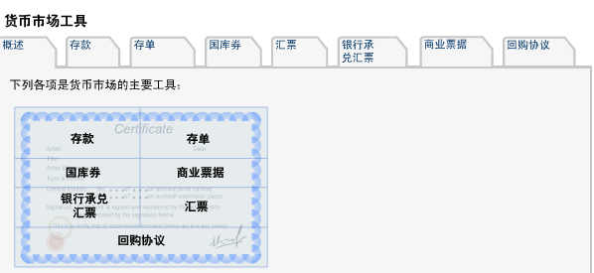
Money Market Instrument
Deposit
Certificated of Deposit
T-Bills
Commercial Paper
Bank Acceptance
Acceptance
Repurchase Agreements
https://www.fdic.gov/about/learn/symbol/

Slide 5
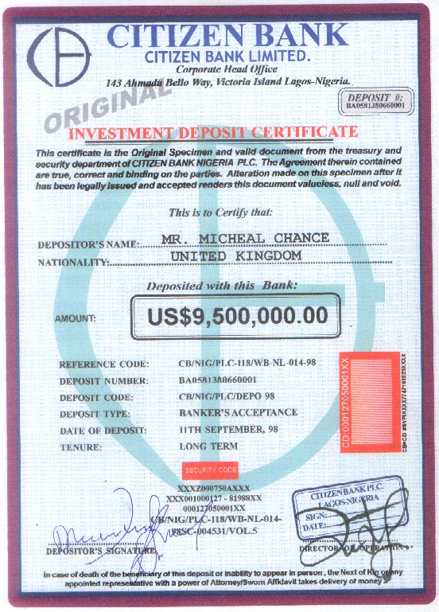
Certificated of Deposit

Slide 6
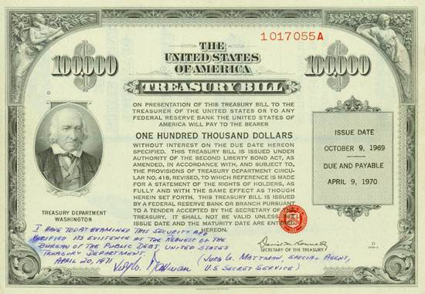
Treasury Bills

Slide 7
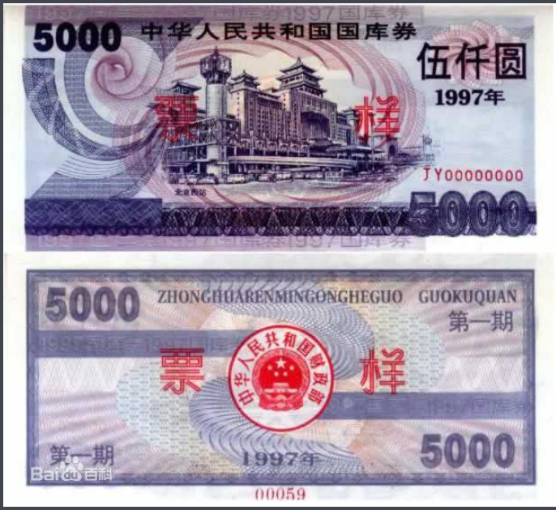

Slide 8
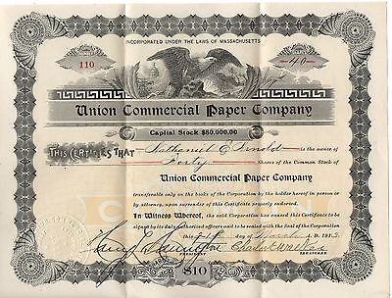
Commercial Paper

Slide 9
Money Market Instruments
货币市场工具 | 发行机构 | 收入性质 | 可转让性
存款 | 银行 | 附息 | 不可转让
存单 | 银行 | 附息 | 可转让
回购协议 | 银行 | 附息 | 不可转让
国库券 | 政府 | 贴现 | 一般持有至到期日
商业票据 | 企业 | 贴现 | 一般持有至到期日
银行承兑汇票 | 企业 | 贴现 | 一般持有至到期日

Slide 10
Interest-bearing tool operation
一间大企业的财务部以4.75%安排了一笔为期92天，本金为USD100,000的短期存款，计算日数常规为A/360， 未来值是多少？
如果我们借了USD100,000，于92天后连本带利还USD100,500，一年的常规日数为360天，试问年利率多少？

Slide 11

Q & A

